Slide 1
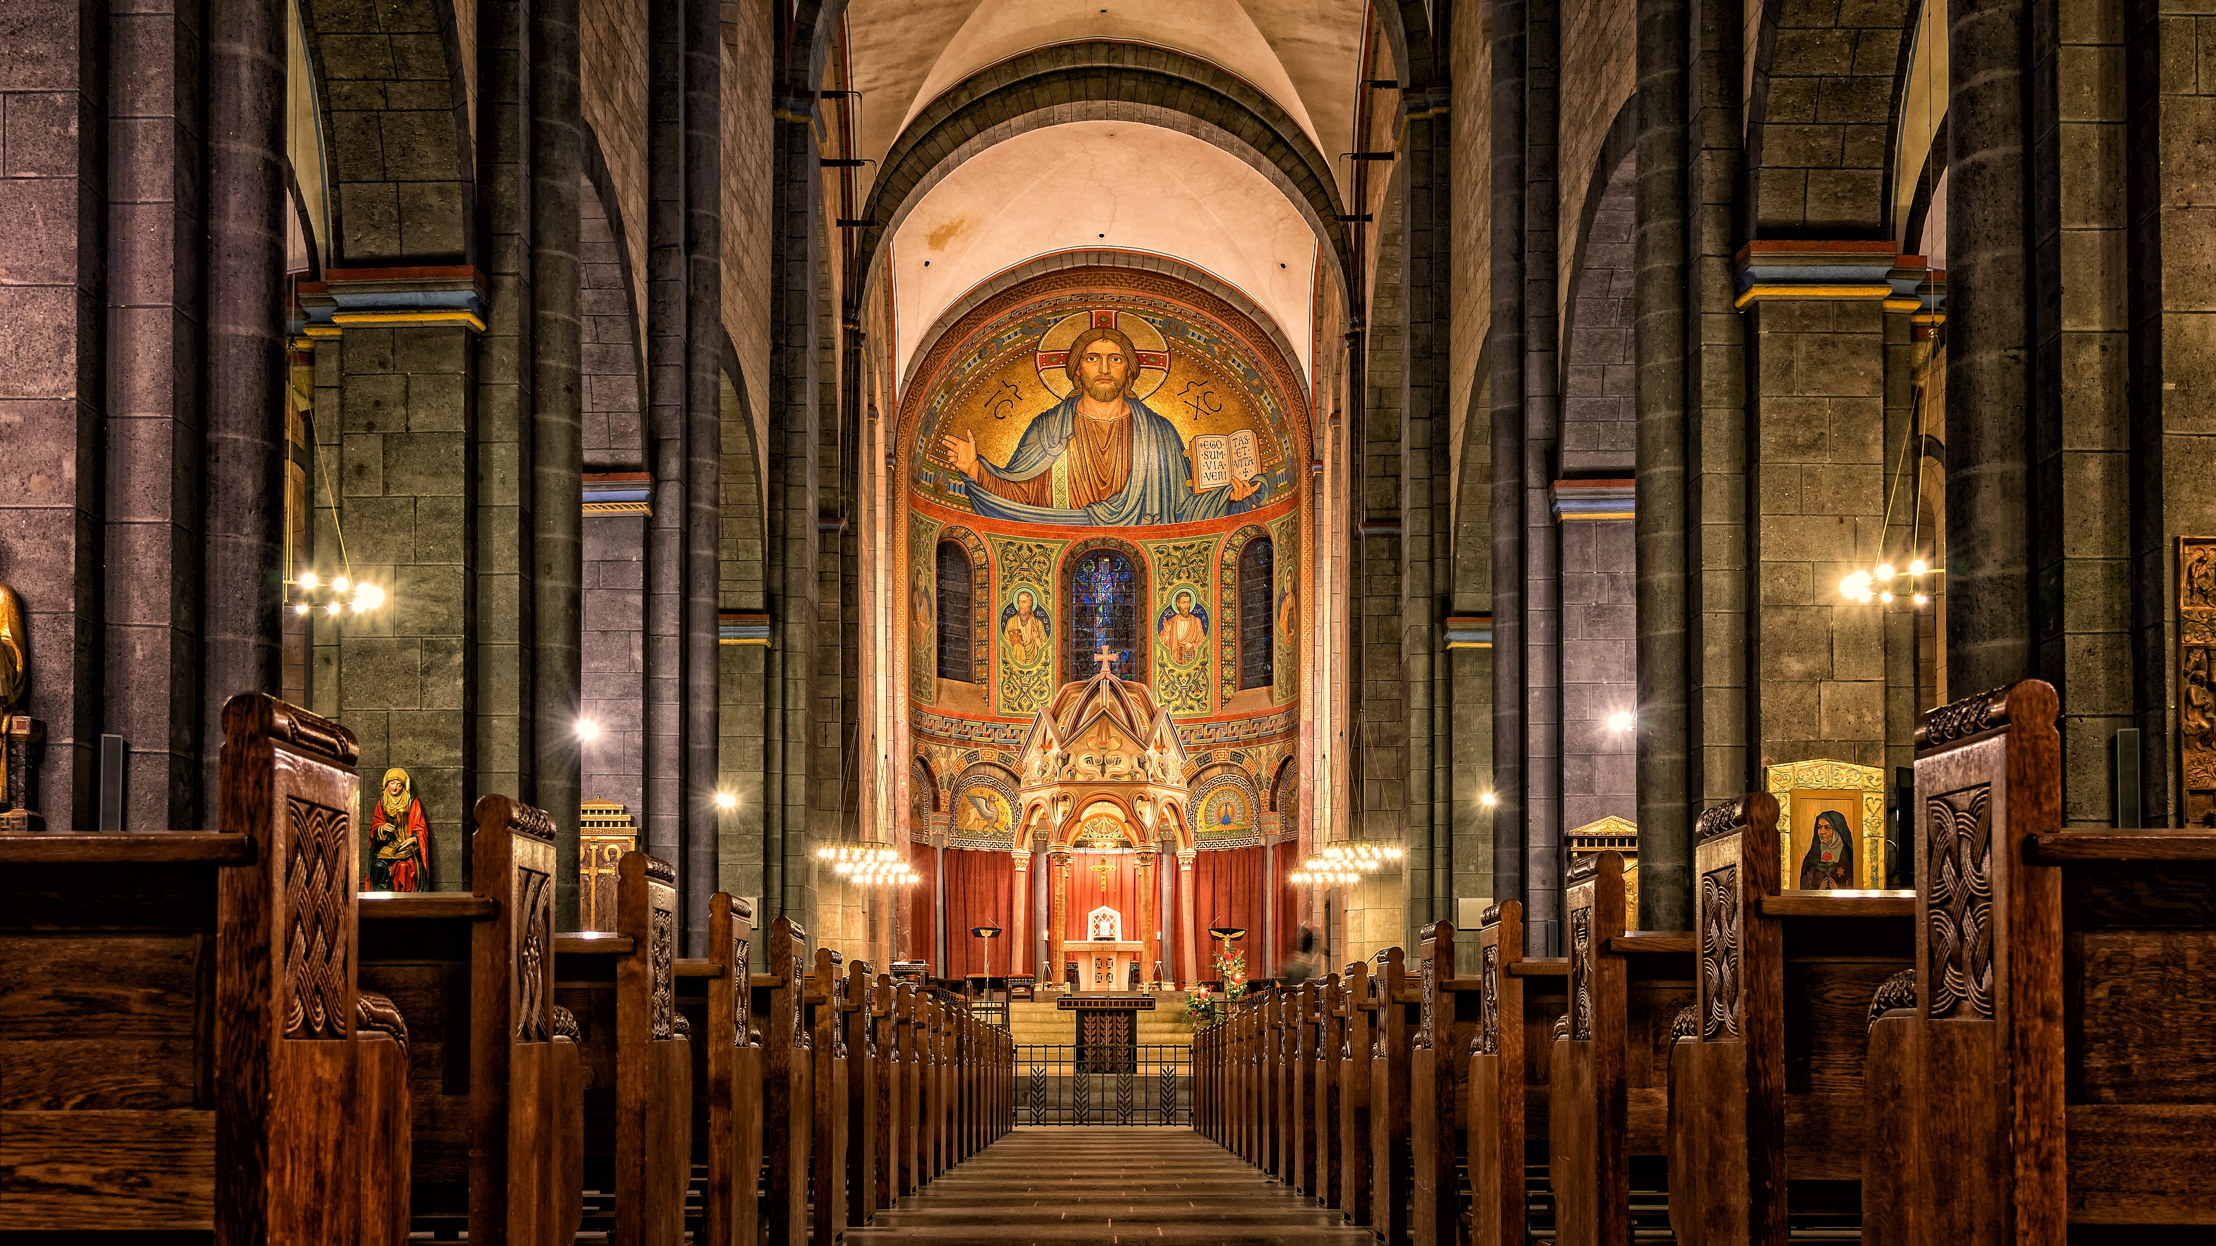
Session 4
Inclusive Theology Discussion

Slide 2
A Covenant Prayer: For Creating Sanctuary Together
Gracious God Under the shadow of your wings We find welcome embrace and compassionate love, And in the coming of your son amongst us, We encounter the outstretched arms of Love without limits.
Help us to be your covenant people Reaching out to one another As Christ has reached out to us.

Slide 3
As we journey together Help us To be treated with care And met with love
To listen to the voices of those least heard And encourage all views to be respected To seek to be genuine and honest And not speak in ways that cause harm
To hold each other’s stories in confidence And exercise grace in our words and actions.
When disturbed or confused, To seek understanding

Slide 4
AMEN
When challenged or moved To embrace the learning
Help us on this journey to be strangers no longer, But pilgrims on the way For the sake of Jesus Who walks with us, breaks bread for us to share, and opens our eyes.

Slide 6
Acts 10
In Caesarea there was a man named Cornelius, a centurion of the Italian Cohort, as it was called. ² He was a devout man who feared God with all his household; he gave alms generously to the people and prayed constantly to God. ³ One afternoon at about three o’clock he had a vision in which he clearly saw an angel of God coming in and saying to him, “Cornelius.” ⁴ He stared at him in terror and said, “What is it, Lord?” He answered, “Your prayers and your alms have ascended as a memorial before God. ⁵ Now send men to Joppa for a certain Simon who is called Peter; ⁶ he is lodging with Simon, a tanner, whose house is by the seaside.” ⁷ When the angel who spoke to him had left, he called two of his slaves and a devout soldier from the ranks of those who served him, ⁸ and after telling them everything, he sent them to Joppa.

Slide 7
⁹ About noon the next day, as they were on their journey and approaching the city, Peter went up on the roof to pray. ¹⁰ He became hungry and wanted something to eat; and while it was being prepared, he fell into a trance. ¹¹ He saw the heaven opened and something like a large sheet coming down, being lowered to the ground by its four corners. ¹² In it were all kinds of four-footed creatures and reptiles and birds of the air. ¹³ Then he heard a voice saying, “Get up, Peter; kill and eat.” ¹⁴ But Peter said, “By no means, Lord; for I have never eaten anything that is profane or unclean.” ¹⁵ The voice said to him again, a second time, “What God has made clean, you must not call profane.” ¹⁶ This happened three times, and the thing was suddenly taken up to heaven.

Slide 8
¹⁷ Now while Peter was greatly puzzled about what to make of the vision that he had seen, suddenly the men sent by Cornelius appeared. They were asking for Simon’s house and were standing by the gate. ¹⁸ They called out to ask whether Simon, who was called Peter, was staying there. ¹⁹ While Peter was still thinking about the vision, the Spirit said to him, “Look, three men are searching for you. ²⁰ Now get up, go down, and go with them without hesitation; for I have sent them.” ²¹ So Peter went down to the men and said, “I am the one you are looking for; what is the reason for your coming?” ²² They answered, “Cornelius, a centurion, an upright and God-fearing man, who is well spoken of by the whole Jewish nation, was directed by a holy angel to send for you to come to his house and to hear what you have to say.” ²³ So Peter invited them in and gave them lodging.

Slide 9
The next day he got up and went with them, and some of the believers from Joppa accompanied him. ²⁴ The following day they came to Caesarea. Cornelius was expecting them and had called together his relatives and close friends. ²⁵ On Peter’s arrival Cornelius met him, and falling at his feet, worshiped him. ²⁶ But Peter made him get up, saying, “Stand up; I am only a mortal.” ²⁷ And as he talked with him, he went in and found that many had assembled; ²⁸ and he said to them, “You yourselves know that it is unlawful for a Jew to associate with or to visit a Gentile; but God has shown me that I should not call anyone profane or unclean. ²⁹ So when I was sent for, I came without objection. Now may I ask why you sent for me?”

Slide 10
³⁰ Cornelius replied, “Four days ago at this very hour, at three o’clock, I was praying in my house when suddenly a man in dazzling clothes stood before me. ³¹ He said, ‘Cornelius, your prayer has been heard and your alms have been remembered before God. ³² Send therefore to Joppa and ask for Simon, who is called Peter; he is staying in the home of Simon, a tanner, by the sea.’ ³³ Therefore I sent for you immediately, and you have been kind enough to come. So now all of us are here in the presence of God to listen to all that the Lord has commanded you to say.”

Slide 11
Gentiles Hear the Good News
³⁴ Then Peter began to speak to them: “I truly understand that God shows no partiality, ³⁵ but in every nation anyone who fears him and does what is right is acceptable to him. ³⁶ You know the message he sent to the people of Israel, preaching peace by Jesus Christ—he is Lord of all. ³⁷ That message spread throughout Judea, beginning in Galilee after the baptism that John announced: ³⁸ how God anointed Jesus of Nazareth with the Holy Spirit and with power; how he went about doing good and healing all who were oppressed by the devil, for God was with him.

Slide 12
³⁹ We are witnesses to all that he did both in Judea and in Jerusalem. They put him to death by hanging him on a tree; ⁴⁰ but God raised him on the third day and allowed him to appear, ⁴¹ not to all the people but to us who were chosen by God as witnesses, and who ate and drank with him after he rose from the dead. ⁴² He commanded us to preach to the people and to testify that he is the one ordained by God as judge of the living and the dead. ⁴³ All the prophets testify about him that everyone who believes in him receives forgiveness of sins through his name.”

Slide 13
Gentiles Receive the Holy Spirit
⁴⁴ While Peter was still speaking, the Holy Spirit fell upon all who heard the word. ⁴⁵ The circumcised believers who had come with Peter were astounded that the gift of the Holy Spirit had been poured out even on the Gentiles, ⁴⁶ for they heard them speaking in tongues and extolling God. Then Peter said, ⁴⁷ “Can anyone withhold the water for baptizing these people who have received the Holy Spirit just as we have?” ⁴⁸ So he ordered them to be baptized in the name of Jesus Christ. Then they invited him to stay for several days.

Slide 14
Luke 24:13-25
The Walk to Emmaus
¹³ Now on that same day two of them were going to a village called Emmaus, about seven miles from Jerusalem, ¹⁴ and talking with each other about all these things that had happened. ¹⁵ While they were talking and discussing, Jesus himself came near and went with them, ¹⁶ but their eyes were kept from recognizing him. ¹⁷ And he said to them, “What are you discussing with each other while you walk along?” They stood still, looking sad.

Slide 15
¹⁸ Then one of them, whose name was Cleopas, answered him, “Are you the only stranger in Jerusalem who does not know the things that have taken place there in these days?” ¹⁹ He asked them, “What things?” They replied, “The things about Jesus of Nazareth, who was a prophet mighty in deed and word before God and all the people, ²⁰ and how our chief priests and leaders handed him over to be condemned to death and crucified him. ²¹ But we had hoped that he was the one to redeem Israel. Yes, and besides all this, it is now the third day since these things took place.

Slide 16
²² Moreover, some women of our group astounded us. They were at the tomb early this morning, ²³ and when they did not find his body there, they came back and told us that they had indeed seen a vision of angels who said that he was alive. ²⁴ Some of those who were with us went to the tomb and found it just as the women had said; but they did not see him.” ²⁵ Then he said to them, “Oh, how foolish you are, and how slow of heart to believe all that the prophets have declared!

Slide 17
Notes:
The video will begin automatically. Before playing, please ensure you are connected to the internet.
The video is also available on our website: www.creatingsanctuary.org.uk/session-4

Slide 18
In light of what you have seen, consider the following:
What elements of the conversation interested or surprised you?
What did you learn from the conversation?
How do you think the conversation could inform our thinking about making churches safer for everyone?

Slide 20
Jesus said: “Father forgive them for they know not what they do.” Luke 23:34

Slide 21
Prayers for forgiveness and reconciliation
Prayer 1
O Holy God, we know we have fallen short. We turn our backs when we could embrace. We remain silent when we could speak. We speak when we could listen. We close the door when we could fling it wide open. We judge when we could seek understanding. We cling when we could give. Forgive us, O God, for being so very human at times, and help us to continue to grow into the people you created us to be, through Christ our Lord.
AMEN

Slide 22
Prayer 2
Great and gracious God, For apathy, For meanness, For boredom, For pride, For judgment, For dismissal: For all those ways we hurt you by hurting each other and ourselves, forgive us. Turn us around to you; heal us, and make us whole, we pray.
AMEN

Slide 23
Prayer 3
There are times, O God, when our greatest sin is not what we do but what we fail to do. For those times when we have not spoken up; for those times when we have not acted; for those times when we have not responded: forgive us.
Give us courage to name what is wrong when we see it. Give us confidence to do what is hard. Give us grace to reach out when that is frightening or uncomfortable.
This we pray in Jesus’ name.
AMEN

Slide 24
Prayer 4
Holy God, we are an imperfect people and we need your love.
Forgive us when we ignore your children who cry out in distress.
Forgive us when we choose not to see those who frighten us, or those who bother us, or those who remind us too much of ourselves.
Forgive us when we put rules ahead of people and choose legality over kindness and judgment that lacks mercy.
Enable us to see as you see, the wide vistas open to the possibility of compassion and grace.
AMEN

Slide 25
Closing Song
In Christ alone my hope is found, He is my light, my strength, my song This Cornerstone, this solid Ground Firm through the fiercest drought and storm. What heights of love, what depths of peace When fears are stilled, when strivings cease My Comforter, my All in All Here in the love of Christ I stand.

Slide 26
In Christ alone! - who took on flesh, Fullness of God in helpless babe. This gift of love and righteousness, Scorned by the ones He came to save Till on that cross as Jesus died, The wrath of God was satisfied For every sin on Him was laid Here in the death of Christ I live.

Slide 27
There in the ground His body lay, Light of the world by darkness slain: Then bursting forth in glorious day Up from the grave He rose again And as He stands in victory Sin’s curse has lost its grip on me, For I am His and He is mine Bought with the precious blood of Christ.

Slide 28
No guilt in life, no fear in death, This is the power of Christ in me From life’s first cry to final breath, Jesus commands my destiny No power of hell, no scheme of man, Can ever pluck me from His hand Till He returns or calls me home Here in the power of Christ I’ll stand.

