Slide 1
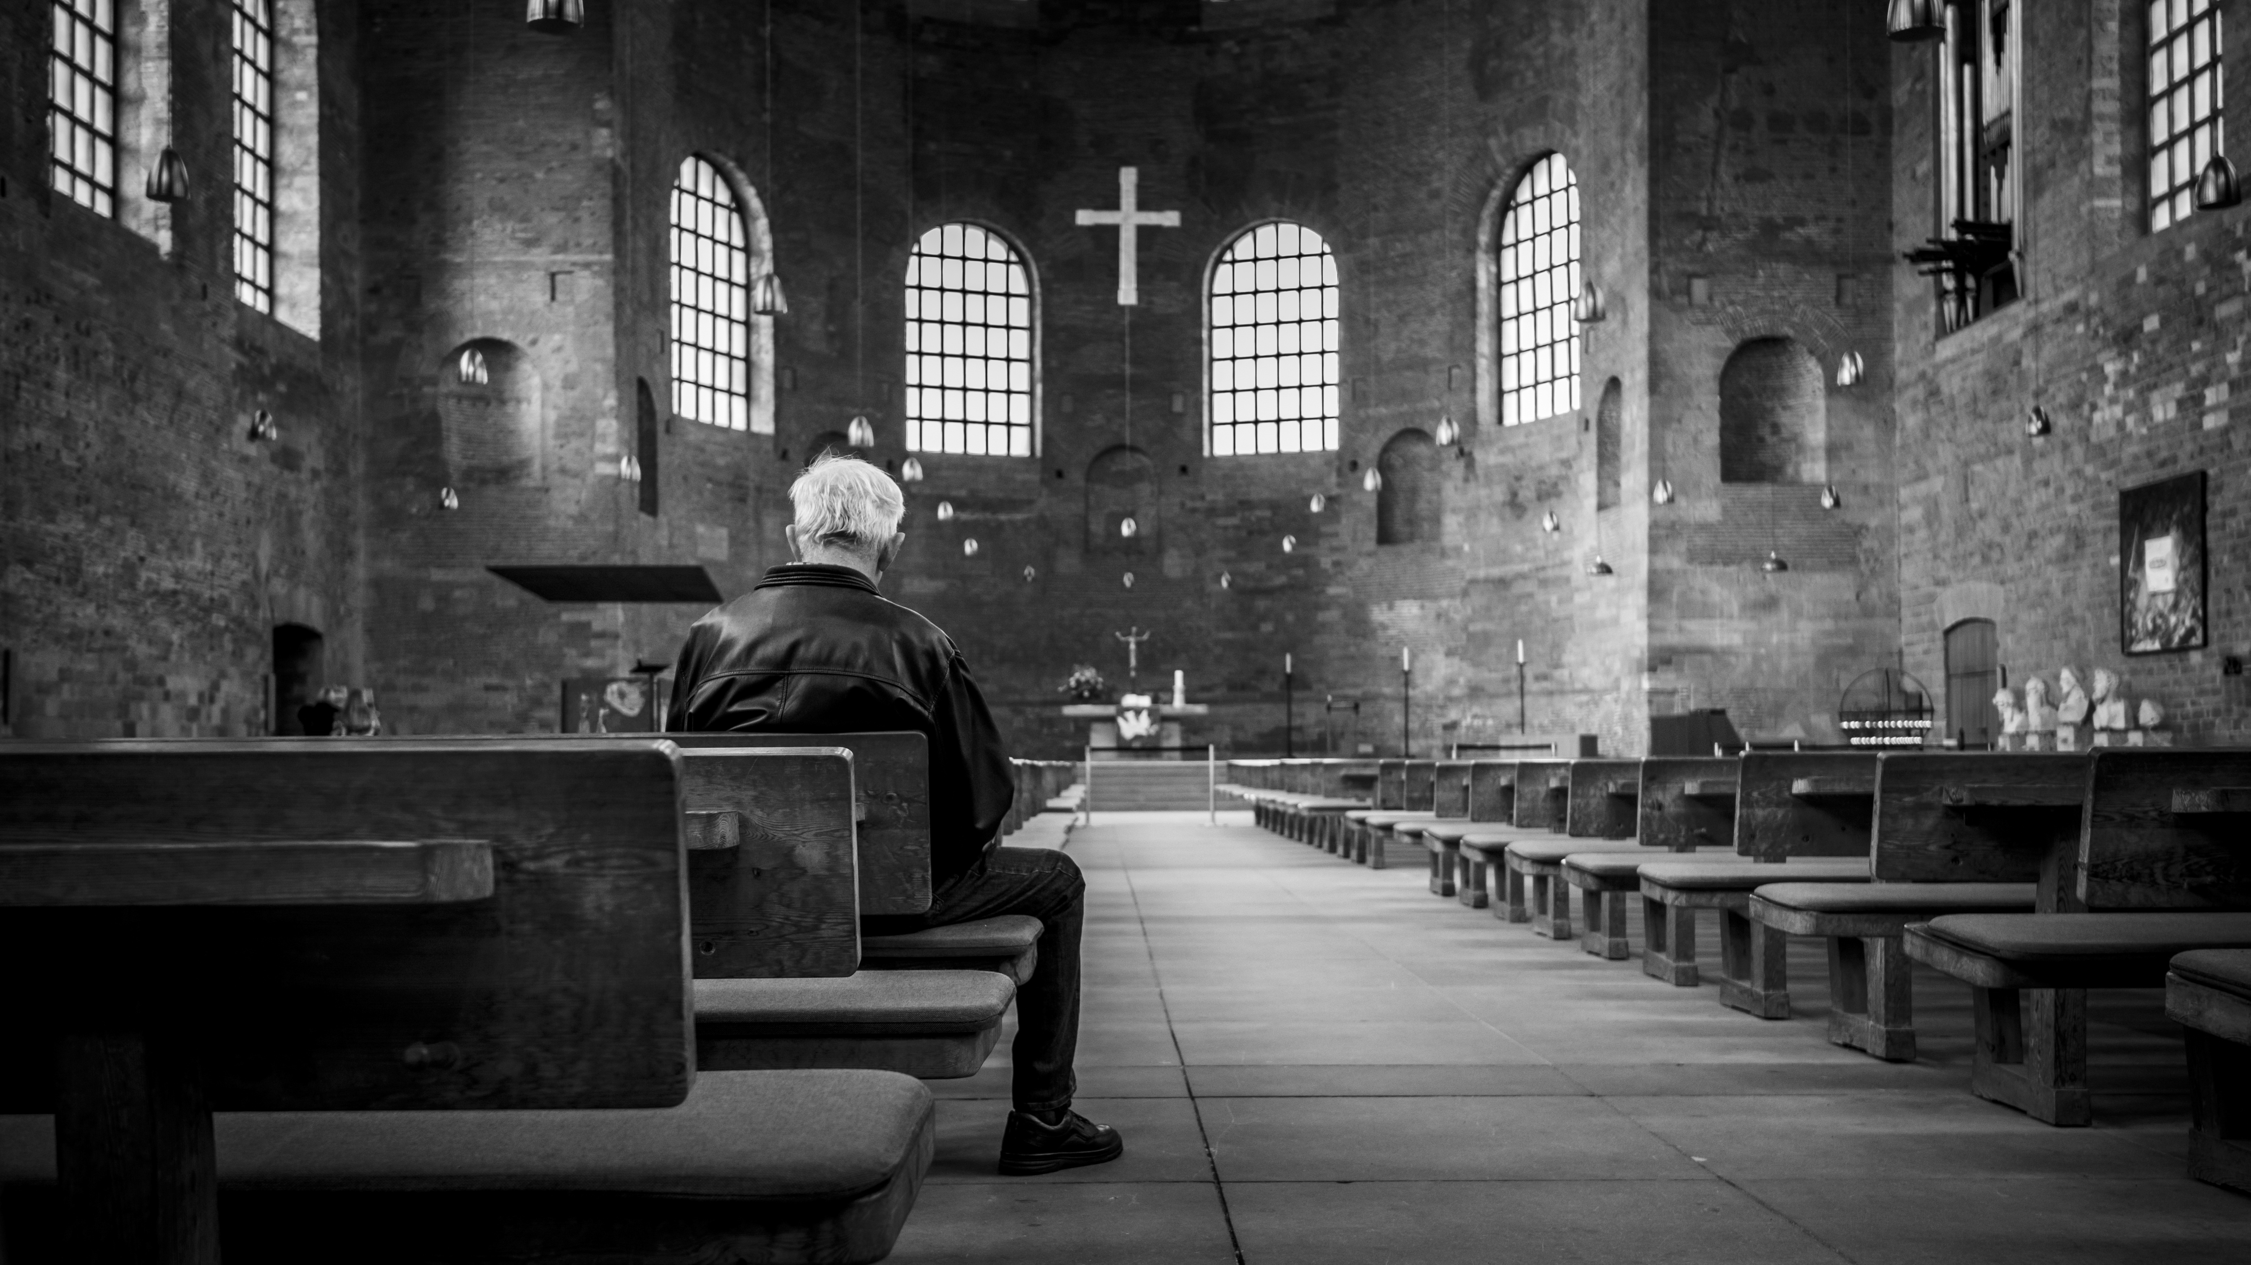
Session 3
We all have a Story

Slide 2
A Covenant Prayer: For Creating Sanctuary Together
Gracious God Under the shadow of your wings We find welcome embrace and compassionate love, And in the coming of your son amongst us, We encounter the outstretched arms of Love without limits.
Help us to be your covenant people Reaching out to one another As Christ has reached out to us.

Slide 3
As we journey together Help us To be treated with care And met with love
To listen to the voices of those least heard And encourage all views to be respected To seek to be genuine and honest And not speak in ways that cause harm
To hold each other’s stories in confidence And exercise grace in our words and actions.
When disturbed or confused, To seek understanding

Slide 4
AMEN
When challenged or moved To embrace the learning
Help us on this journey to be strangers no longer, But pilgrims on the way For the sake of Jesus Who walks with us, breaks bread for us to share, and opens our eyes.

Slide 6
“I thirst”
John 19:28

Slide 7
Pause and Reflect
We thirst! All of us thirst; For recognition, friendship, inclusion; truth.
We thirst, all of us thirst; For authenticity, acceptance, understanding; for permission to be who we wholly are.
It is our basic need, A fundamental requirement of humanity. To be fully seen.

Slide 8
Lord, when you were thirsty, they mocked you, It may have appeared to those standing by that they met your need, Yet what you were offered was not what you needed, it would never have been enough.
God, we thirst.
In a world often parched and arid from a lack of authenticity and welcome, Where often we too have failed to meet the needs of the other We too have wanted to be seen to serve, We too have caused insult, offering a second-rate solution.

Slide 9
God, we thirst, all of us thirst, From our need for others,
Our need for you, Our need for love.

Slide 10
A Prayer for Discernment
As we share our stories
May the Spirit quench our thirst for truth and understanding
May the crucified and risen Lord meet us in our need
May God at work in lives so different from our own, kindle within us a deep love and friendship for all
AMEN

Slide 12
Prayer
Around the Cross of Christ, we stand together, Here is a place of grace, where we realise that we are all in need of Jesus Here is the great leveller, Where the broken find healing, Where the lost are found Where the outcast is welcomed The place where love, mercy, and hope abound. Here we stand, never alone, always with others, Others just like us, in need of Jesus.

